Slide 1
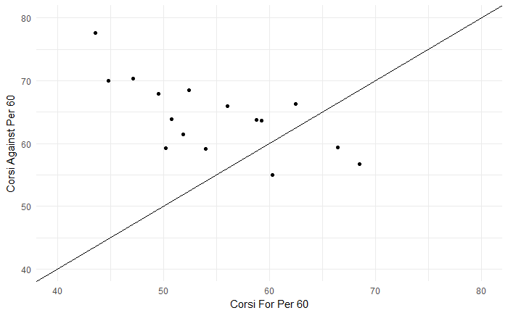
Bad
All Offense
Fritz
Prince
Quine
Chimera
Clutterbuck
Bailey
Beauvillier
Nelson
Tavares
Cizikas
Lee
Kulemin
Ho-Sang
Barzal
Ladd
Eberle
All Defense
Good

